Slide 1

How to measure and gain customer satisfaction
Best practices from Microsoft & IAMCP Russia
Danil Dintsis,
IAMCP Russia, Lead
iamcp@live.ru, dinzis@specialist.ru

Slide 2
WIIFM – What In It For Me (Us)
IAMCP membership must be “the high quality rate” for customers
We create value for our customers as Association

Slide 3

The best contractor – what does SMB customer mean?
Cost?
Cost vs Quality?
Market leader?
Best support?
…

Slide 4


Common questions
What do I need?
What my contractor is?
Preferable criteria?

Slide 5
Main issues for quality ratings
Who are the main interviewees?
    Business customers
    End users
Emotions are hard to formalize
    personnel tolerance
    personal mode
    Different targets & interests
Costs for reviewing contractors experience
  IT department is overloaded

Slide 6
Problems & issues for IT companies
Unsatisfied customers
Less contracts
Less money (Per: tens of billions dollars are not spent by potential contractors)

Slide 7

What’s your experience

Slide 8
Offer a roadmap to our customers:
IAMCP Russia initiative: roadmap for a customer
Microsoft Russia initiative: competition named “The effective CR monetization practices”
Unified initiative: exchange experience at member meeting, and formalize it

Slide 9


IAMCP’s roadmap for customers
Idea: classify contractors
Offer roadmap for customers

Slide 10
IT services market
Highly competitive
Mental experiment: each service is provided by different contractors.
What are the results? Compare them

Slide 11
Price
Celebrity
Star
Mid-level
Workaholic
Beginner
Quality

Slide 12
Contractors’ types
Star: Extra high quality and prices, well known brand-name
Workaholic : Growing company; not widely known, but provides high quality and CR.
Middle-level: average quality, average prices.
Beginner: start-up, average quality, a lot of enthusiasm .
Celebrity: high prices, well-known, average quality or a bit higher
Looser: low prices, and low quality.

Slide 13
Does a customer need the star?
Star: Sometimes. Special conditions
Workaholic: the best choice often
Middle-level: Maybe
Beginner: Think about it!

Slide 14
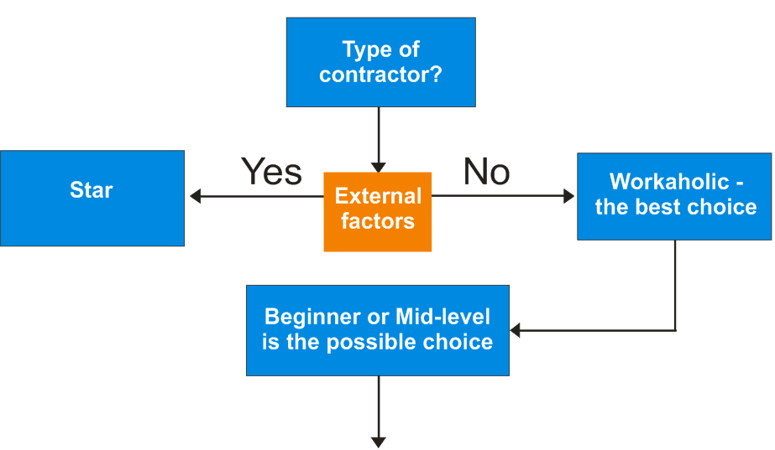

Slide 15
Tips for SMB customer
Average market prices
Type of IT service (critical, high priority, common)
Reference visits and calls
Criticism? No? It’s suspicious
Contractor experience?
Management compatibility (ITIL, MOF, COBIT, PMBoK, Agile)
Continuous service improvement
Pre-contract investigation

Slide 16
The effective CR monetization practices competition
Microsoft Russia
https://partner.microsoft.com/rus/trainingevents/40182056 - in Russian

Slide 17
Business cases’ demands
CR business practice description: marketing initiatives, loyalty programs, customer satisfaction research, motivation, trainings, etc.
Result measurement technique
Examples. Results. Charts

Slide 18
The effective CR monetization practices competition criteria
Business effect proved by participant;
CR practices integration with business processes
Innovations
Scalability

Slide 19
Prizes for winners
Award ceremony at Worldwide Partner Conference 2012;
1st prize. Media projects in leading mass media; press release with Microsoft Russia;
2nd prizez (3 companies). Press release at Microsoft Russia resources
IAMCP Russia publishes a book with best practices for partners and clients

Slide 20

Specialist CTEC case
Exit Rate
Landing Rate
Balls Rate
…and CSAT
Notes:
Exit Rate, коэффициент ухода у вас 80%. Это те, кто не продолжил. То есть этот показатель должен быть минимальным. Balls Rate – это число слушателей, которые вообще прошли только один этот курс, а Landing Rate – число слушателей, для которых этот курс стал первым.

Slide 21
Specialist CTEC BPs
Low Exit Rate – extend product line!
Low Exit Rate & high Balls Rate – extend product line, train sales personnel
High Exit Rate – low quality: audit product, control production personnel
Notes:
Exit Rate, коэффициент ухода у вас 80%. Это те, кто не продолжил. То есть этот показатель должен быть минимальным. Balls Rate – это число слушателей, которые вообще прошли только один этот курс, а Landing Rate – число слушателей, для которых этот курс стал первым.

Slide 22
Specialist CTEC additional analysis tools & tips
Early feedbacks: Successful start=50% of total success
Monitoring of customers: after 3 months, 1 year later. Compare secondary client’s flow
Contact both managers and users at client side
Notes:
Exit Rate, коэффициент ухода у вас 80%. Это те, кто не продолжил. То есть этот показатель должен быть минимальным. Balls Rate – это число слушателей, которые вообще прошли только один этот курс, а Landing Rate – число слушателей, для которых этот курс стал первым.

Slide 23
Specialist CTEC 5-year trends

Slide 24
Results from CSAT
KPIs | Results | Market average
NSAT (General satisfaction index) | 178 | 164
Customer loyalty index | 92 | 87
Ready to recommend | 97 | 92
General Productivity | 84 | 67

Slide 25
Activities by
IAMCP and Microsoft Russia
Business trainings (virtual) for free
Special chapter meeting
Business brochure by IAMCP Russia
WPC 2012 presentation and winner’s award by Microsoft Russia

Slide 26

Member’s benefits
Satisfied clients and users
IAMCP as competency center
Competitive advantages as trusted contractors

Slide 27
Thank you!
And thanks to our united team:
IAMCP Russia:
Maxim Gvozdev (CEO at www.Lean4systems.ru)
Dmitry Gudzenko (CEO at www.specialist.ru)
Anna Makeeva (www.crosys.ru)
and MSFT Russia:
Natasha Boldyreva, Anna Albova, Zhenya Voronin

Slide 28
Our web resources
http://iamcpru.wordpress.com = www.иамсп.ру
https://www.facebook.com/#!/groups/iamcpru/
iamcp@live.ru

Slide 29
Questions & discussion
dinzis@specialist.ru
iamcp@live.ru

